Slide 1
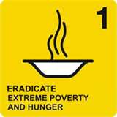


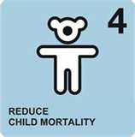

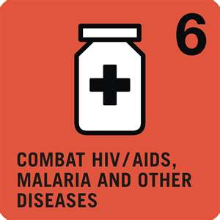


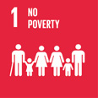

















Achievement of MDGs and Adaptation of SDGs: Context Bangladesh
Dr. Arafatur Rahman
Deputy Program Manager, DGHS
Ph: 01717862078

Slide 2

Eight Millennium Development Goals
(2) Primary Education
(1) Poverty and Hunger
(3) Empower Women
By
2015
193 Member States
(4) Child Mortality
(5) Maternal Health
(6) HIV/AIDS and other Diseases
(8) Partnership for Development
(7) Environmental Sustainability

Slide 3
Bangladesh MDGs achievements: International recognition
Hon’ble Prime Minister of Bangladesh was awarded with ‘UN MDG Awards 2010’ for reducing under five child mortality rate (MDG-4).
Bangladesh received South-South Award 'Digital Health For Digital Development' for success on attainment of MDG- 4 & MDG-5.
Bangladesh received ‘Diploma Award’ from Food and Agriculture Organization (FAO) for achieving the MDG-1.
Bangladesh was honoured with the ‘special recognition’ for outstanding progress in fighting hunger and poverty.
Hon’ble Prime Minister was awarded ‘UNESCO Peace Tree Award’ for her commitment to women’s empowerment and girls’ education.
Bangladesh received ‘Women in Parliaments Global Forum Award’, as Bangladesh ranked 10th out of 142 countries in the political sphere.
Hon’ble Prime Minister was awarded “Champions of the Earth” by UNEP for Policy Leadership.
The UN-Women recognised our Hon’ble Prime Minister as "Planet 50-50 Champion"
The Global Partnership Forum awarded Hon’ble Prime Minister "Agent of Change Award" for her outstanding contributions to women empowerment.

Slide 4
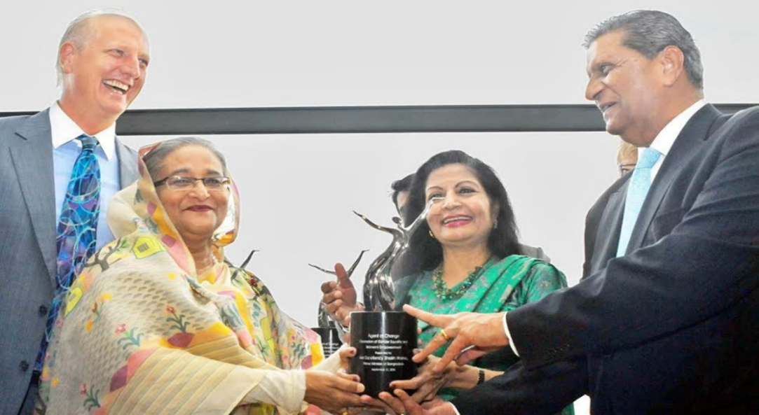
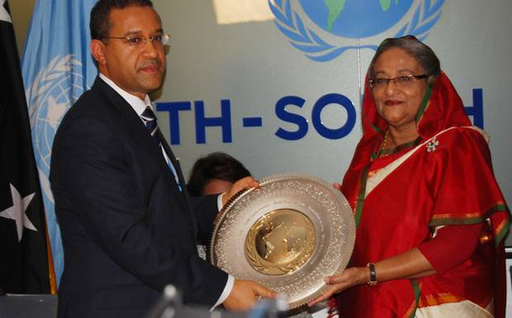
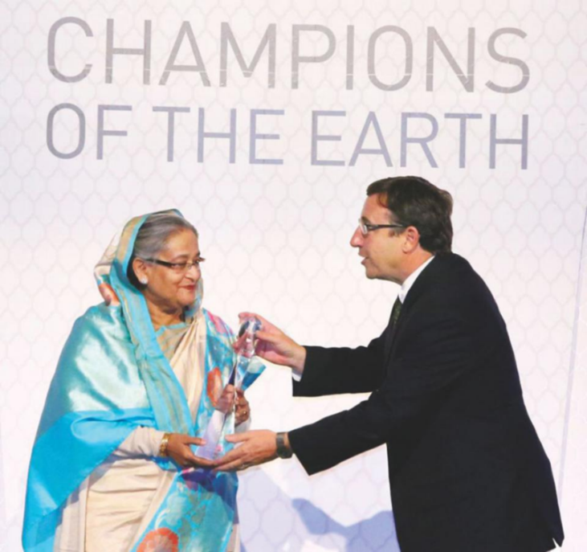
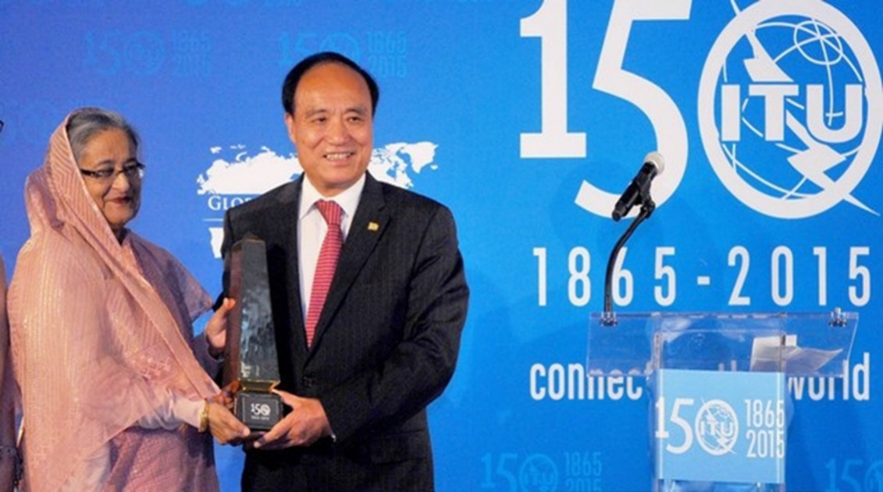


Slide 5
Goal 1: Eradicate Extreme Poverty & Hunger
With sustained GDP growth rate of over 6%, the MDG target of halving the population living under the poverty line (from 56.7% to 29%) was achieved by 2012, three years ahead of the target date.
The social protection allocation was increased from 1.98% of GDP in FY 09 to 2.30% in FY 15.
Half of the total budget expenditure has been related to poverty reduction for the last seven years.
Targets Achieved | Base Year 1990-91 | Current Status | Target 2015 | Status
Proportion of people below national upper poverty line (%) (Cost of Basic Need=CBN method) | 56.7 | 24.8 (GED 2015) | 29.0 | Goal met
Poverty gap ratio (%) | 17.0 | 6.5 (HIES 2010) | 8.0 | Goal met
Prevalence of underweight children under –five years of age (6-59 months), (%) | 66.0 | 32.6 (BDHS2014) | 33.0 | Goal met
% of people below minimum level of dietary energy consumption (1805 kcal/day) (Direct Calorie Intake = DCI) | 28.0 | 16.4 (Estimate for 2015 by UNSD) | 14.0 | On Track
Notes:
Poverty gap ratio is the mean distance separating the population from the poverty line (with the non-poor being given a distance of zero), expressed as a %age of the poverty line. Poverty gap estimates how far below the poverty line the poor are on average as a proportion of the value of that line. The poverty gap ratio is an indicator that measures the depth of poverty. It is the aggregate income deficit of the poor relative to the poverty line, and gives an idea of the resources needed to raise the poor above the poverty line.
5

Slide 6
Goal 2: Achieve Universal Primary Education
Net Enrolment Ratio: Bangladesh was well ahead than the regional neighbors, except India and Nepal
Literacy rate: Bangladesh is better than India and Pakistan along with other South Asian counterparts except Maldives and Sri Lanka.
A major milestone in the education sector is the adoption of National Education Policy 2010, which the government is implementing.
Targets Achieved | Base Year | Current Status | Target 2015 | Status
Net Enrolment Ratio in Primary Education (%) | 60.5 | 98 (2015, DPE) | 100.0 | Goal met
Proportion of pupils starting grade 1 who reach grade 5 (%) | 43.0 | 81.3 (2015, DPE) | 100.0 | Substantial Achievement
Literacy rate of 15-24 year olds, women and men, % | - | 75.4 (Pop. Cens., BBS 2011) | 100.0 | On Track

Slide 7
Goal 3: Promote Gender Equality and Empower Women
Bangladesh has been maintaining gender parity at secondary education level during the last 15 years.
Gender parity at the secondary level is highest in Bangladesh, followed by Maldives, Bhutan, Sri Lanka and Nepal.
With respect to share of women in wage employment in the non-agriculture sector, Bangladesh outperformed India, Pakistan, Nepal, Afghanistan and Bhutan.
Targets Achieved | Base Year | Current Status | Target 2015 | Status
Ratio of girls to boys in Primary education (Gender Parity Index, GPI=Girls/Boys) | 0.83 | 1.04 (DPE 2015) | 1.0 | Goal met
Ratio of girls to boys in Secondary education (Gender Parity Index, GPI=Girls/Boys) | 0.52 | 1.14 (BANBEIS 2015) | 1.0 | Goal met
Ratio of girls to boys in Tertiary education (Gender Parity Index, GPI=Girls/Boys) | 0.37 | 0.65 (BANBEIS 2015) | 1.0 | Substantial Achievement

Slide 8
Goal 4: Reduce Child Mortality
In order to strengthen primary healthcare facilities, the government has launched 13,126 community clinics during the 6th FYP period.
The under-five mortality rate per 1000 live births in Bangladesh is lower than that of India and Pakistan.
Bangladesh also performed better than India and Pakistan in case of infant mortality and children 1 year old immunized against measles.
Targets Achieved | Base Year | Current Status | Target 2015 | Status
Under-five (6-59 months) Mortality Rate (per 1000 live births) | 146 | 36 (SVRS 2015) | 48 | Goal met
Infant (0-1 year) Mortality Rate (per 1000 live births) | 92 | 29 (SVRS 2015) | 31 | Goal met
Proportion of 1 year-old children immunized against measles (%) | 54 | 80 (BDHS 2014) | 100 | Substantial Achievement

Slide 9
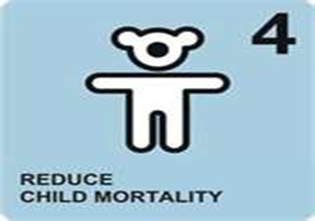
Long term IMR and U5MR of Bangladesh

Slide 10
Goal 5: Improve Maternal Health
Contraceptive Prevalence Rate & Maternal Mortality Ratio: Other than Maldives and Sri Lanka, Bangladesh’s achievement is impressive than other South Asian countries.
Health and Population Sector Programme (HPSP), followed by Health Population and Nutrition Sector Development Program (HPNSDP) sought to improve the state of health of the people of the country with focus on women, child and the poor.
Targets Achieved | Base Year | Current Status | Target 2015 | Status
Maternal Mortality Ratio ( per 100,000 live births) | 574 | 176 (MMEIG 2015) | 143 | Substantial Progress
Proportion of births attended by Skill Health Personnel (%) | 5.0 | 42.1 (BDHS 2014) | 50.0 | Ditto
Contraceptive Prevalence Rate (%) | 39.7 | 62.1 (SVRS 2015) | 72 | On Track
Antenatal Care coverage (at least 1 visit) % | 27.5 | 75 (SVRS 2015) | 100 | Substantial Progress
Antenatal Care coverage (at least 4 visits) % | 5.5 | 31.2 (BDHS 2014) | 50 | Ditto

Slide 11

MMR and Birth attended by Skilled HP

Slide 12
Goal 6: Combat HIV/AIDS, Malaria and Other Diseases
Bangladesh’s performance in Halting HIV/AIDS is inspiring compared to the South Asian neighbors.
Notwithstanding the success in containing Tuberculosis, TB prevalence rate is still highest in Bangladesh among the regional countries
Targets Achieved | Base Year | Current Status | Target 2015 | Status
HIV prevalence among population (%) | 0.005 | <0.1 (UNAIDS 2013) | Halting | On Track
Prevalence of Malaria per 100,000 Pop^{n} | 776.9 | 434 (NMCP 2014) | 310.8 | Substantial Progress
Deaths of Malaria per 100,000 Pop^{n} | 1.4 | 0.34 (NMCP 2014) | 0.6 | Goal met
Proportion of children U5 sleeping under insecticide treated bed nets (%) | 81 | 92.2 (NMCP 2014) | 90 | Goal met
TB Case Notification rate (all forms) per 100,000 population per year | 59 | 53 (WHO 2014) | 120 | Goal met
Cure Rate of TB under DOTS (%) | 73 | 92 (WHO 2014) | > 90 | Goal met

Slide 13
Goal 7: Ensure Environmental Sustainability
In case of Using Improved Drinking Water Sources Bangladesh’s performance is impressive comparing to India and Pakistan.
In case of access to improved sanitation, Bangladesh has been doing better than Afghanistan, India, Nepal, Bhutan and Cambodia.
Despite positive picture in afforestation, extensive clearing of forests for agriculture, homestead and other non-forest purpose thwart attaining of the target
Targets Achieved | Base Year | Current Status | Target 2015 | Status
Proportion of land area covered by forest (%) | 9.0 | 13.40 (TD>=30%) (DoF) | 20.0 (TD>=70%) | Substantial Progress
Consumption of ozone –depleting substance in Ozone Depletion Potential (ODP) tonnes | 72.6 | 64.9 (DoE, 2013) | 65.39 | Goal met
Proportion of people using an improved Drinking Water Sources | 78 | 97.9 (SVRS 2015) | 100 | Goal met
7.9: Proportion of population using an improved sanitation facility | 34 | 73.5 (SVRS, 2015) | 100 | Substantial Progress

Slide 14
Goal 8: Develop a Global Partnership for Development
Between 1990-91 and 2014-15, the disbursement of ODA as a proportion of Bangladesh’s GDP has fallen from 5.59 per cent to 1.56 per cent.
Developing and least developed countries did not get promised financial assistance from most of the OECD/DAC countries.
Indicators | Base Year | Current Status | Status
Net ODA received by BD in billion US$ | 1.73 | 1.79 (Ave. FY91 to FY15; GED, 2015) | -
Net ODA received by BD as % of OECD/DAC donors’ GNI (FY: 14) | - | 0.002 (ERD, FY14) | -
Average tariff imposed by developed countries on agricultural products, textile & clothing (%) | 12 | 0-9 (BTC,2011) | -
Debt Service as % of exports of goods & services (%) | 20.9 | 5.1 (ERD, FY15) | Highly Impressive
Cellular subscribers per 100 population | - | 80 (BTRC, June 2015) | Highly Impressive

Slide 15
Area of Attention Required for Fulfilling the unfinished MDGs
Unemployment and underemployment is still persistent especially among the young people between 15 to 24 years of age.
Addressing stunting and wasting will be a major concern to improve nutritional wellbeing.
Reducing income inequality and the low economic participation of women remain as matter of concerns.
Primary education completion rate and the adult literacy rate are yet to obtain.
Quality of education is a challenge at the primary and higher secondary levels.
Inequalities remain in maternal health.
Prevalence of malaria is still high even though death incidences are reduced.
Prevalence of TB and TB mortality targets are yet to be achieved.
Tree coverage and proportion of protected terrestrial and marine areas is much less.
Access to safe water for all is still a challenge.
One-third population are not using improved sanitation.
Capacity to raise public resources domestically is limited.

Slide 16
The SDGs are …
A set of 17 goals for the world’s future, through 2030
Backed up by a set of 169 detailed Targets
Emerged from the most inclusive process in the UN’s history, with the involvement of approximately 8.5 million people or organizations (GOB proposed: 11 Goals, 58 Targets & 241 Indicators)
Negotiated over a two-year period at the United Nations (March 2013 to August 2015)
136 Heads of State or Government was present (25th September 2015).
232 indicators
169 targets
17 goals
SDGs

Slide 17

Transforming Our World: the 2030 Agenda for Sustainable Development
‘Transforming Our World: the 2030 Agenda for Sustainable Development’ was adopted on 25 September 2015.
It is composed of:
-a preamble,
-a declaration,
-17 SDGs &
-169 supporting targets,
-MOI and
-the Global Partnership,
-a framework for follow-up and review of implementation.
VISION
— & —
PRINCIPLES
Reflected in declaration
Means of implementation
Global Partnership
Means of Implementation (MoIs)
IMPLEMENTATION
RESULTS FRAMEWORK
Sustainable
Development
Goals
FOLLOW-UP & REVIEW

Slide 18
MDGs versus SDGs
MDGs was based on UN Millennium Declaration (2000) and SDGs are based on UNCSD (Rio+20 declaration, 2012).
In the SDGs, unfinished agenda of MDGs are carried forward along with inclusion of human rights, peace, access to justice, energy, growth & employment, innovation & industrialization, urbanization & climate change issues.
The MDG period was 2001-2015 and the SDG period is 2016 to 2030.
MDG started with 8 goals, 18 targets and 48 indicators (later 20 targets & 60 indicators). SDGs starts with 17 goals, 169 targets and 232 indicators. (6 indicators used twice; 3 indicators thrice)
MDGs were built on top down approach, but SDGs are built on bottom up approach.
MDGs were mainly focused for the LDCs but SDGs are universal. UNIVERSALITY
Goal to goal linkages were missing in MDGs but well inter-linkages among the goals are there is SDGs. INTEGRATION
MDGs focused on National level only quantitative data. But SDGs focuses on quantitative and qualitative disaggregated data. TRANSFORMATION
Hunger was treated as part of poverty in MDGs but hunger is now treated as part of food security and nutrition in the SDGs.
Private sector was not involved in the MDGs implementation, but in SDGs they are treated as important players.

Slide 19
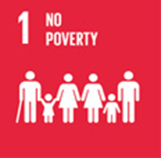
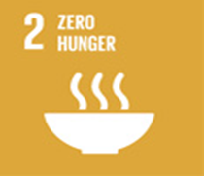
















Slide 20
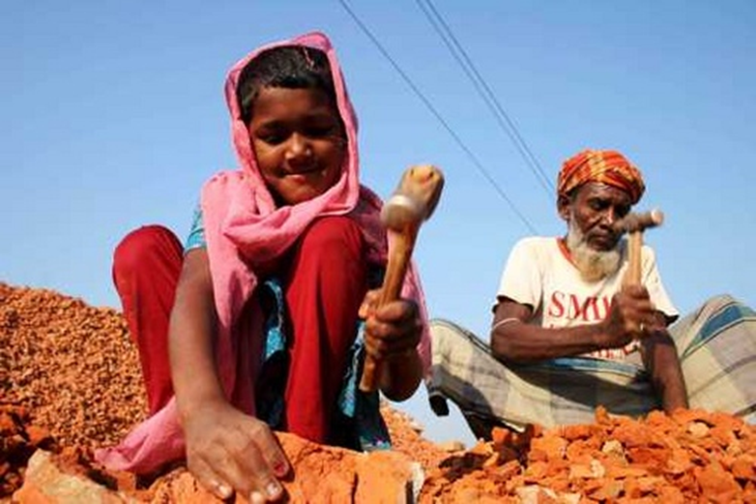
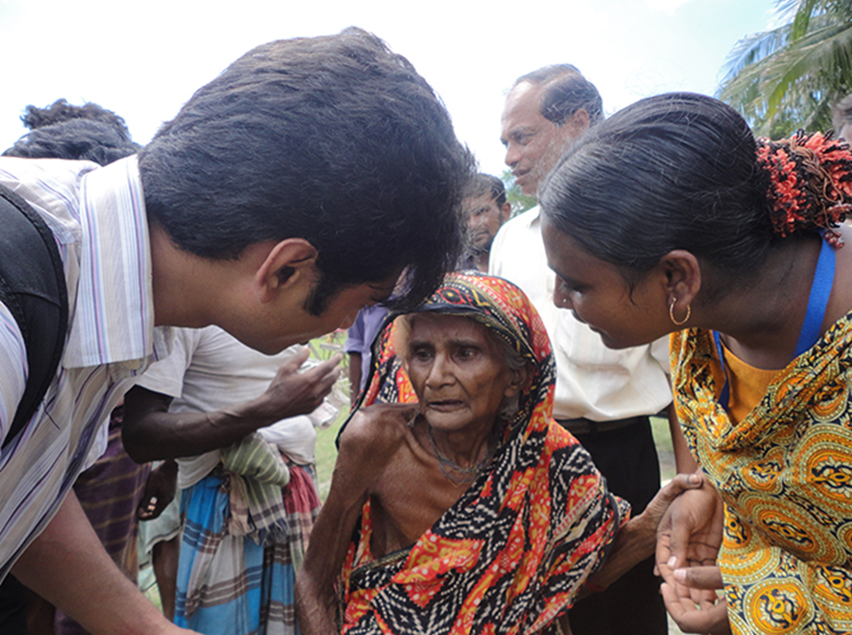
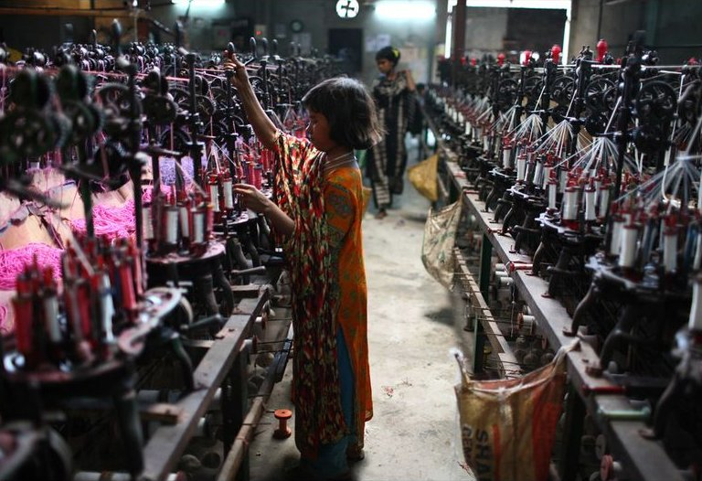
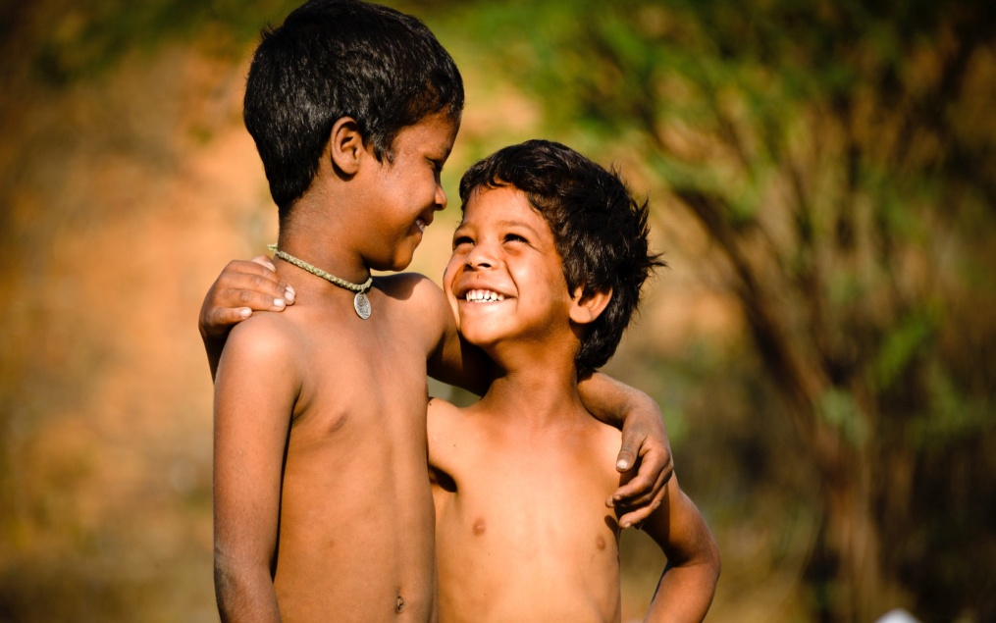

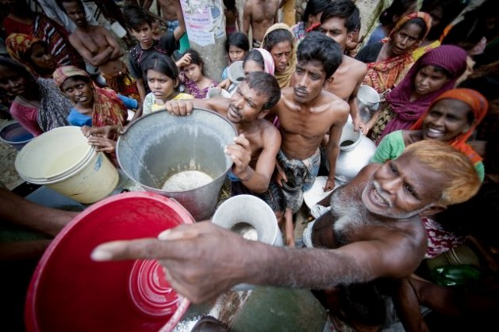
SDG # 1: End poverty in all its forms everywhere

Slide 21
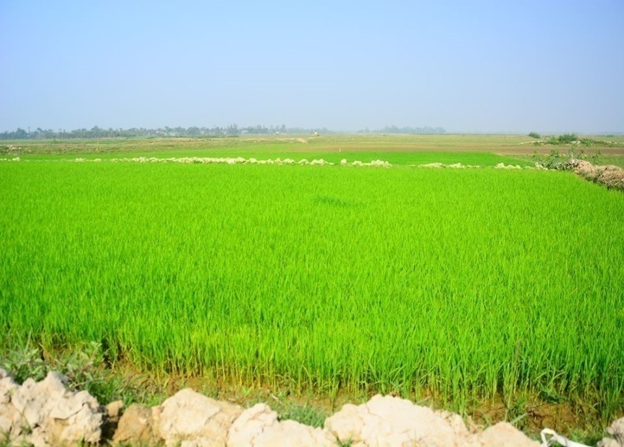
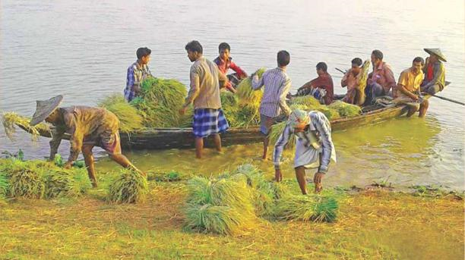
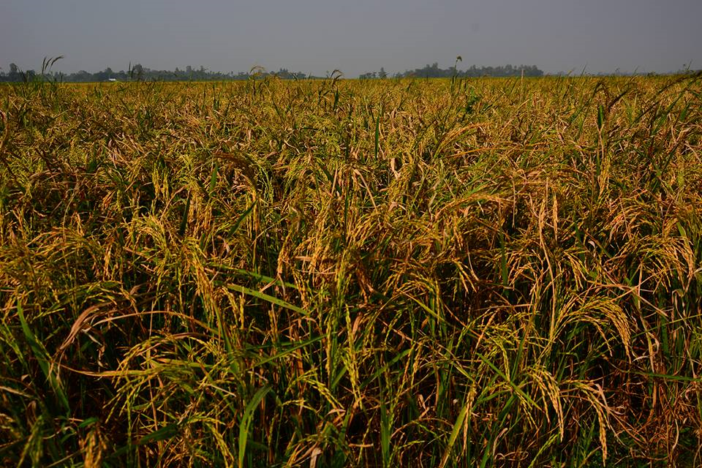
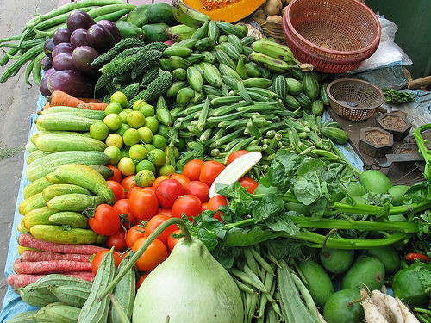
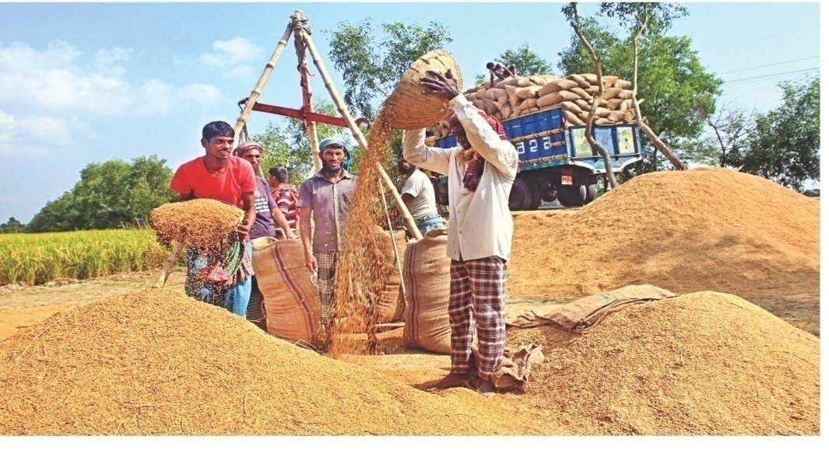
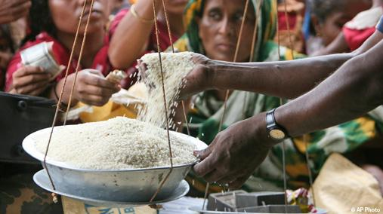
SDG # 2: End hunger, achieve food security and improved nutrition and promote sustainable agriculture

Slide 22
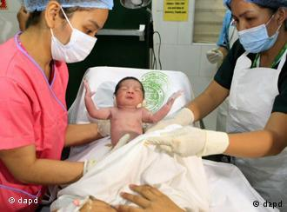
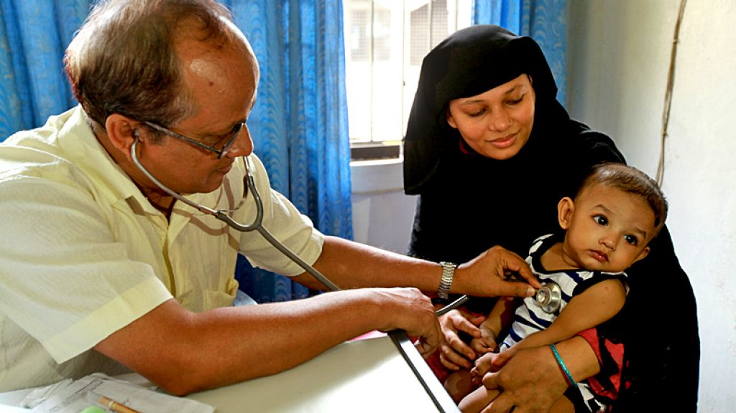

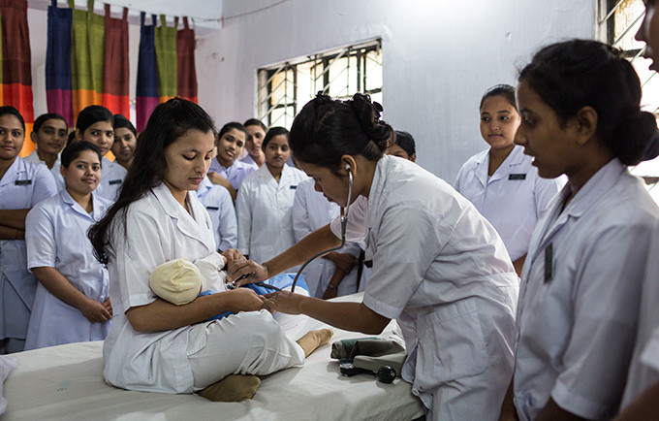
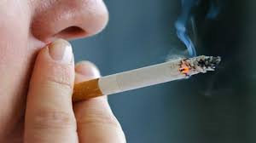
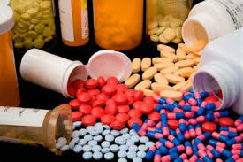
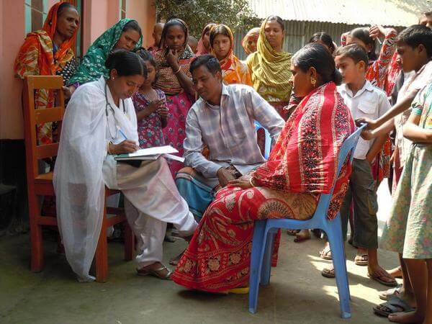
SDG # 3: Ensure healthy lives and promote well-being for all at all ages

Slide 23
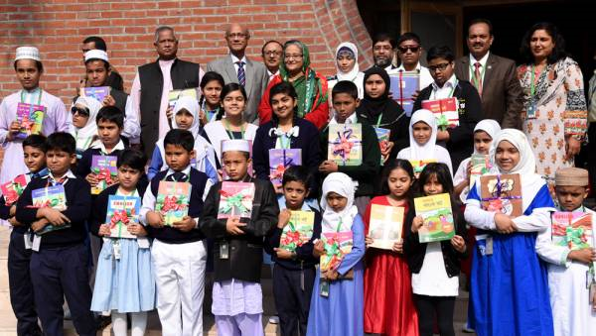
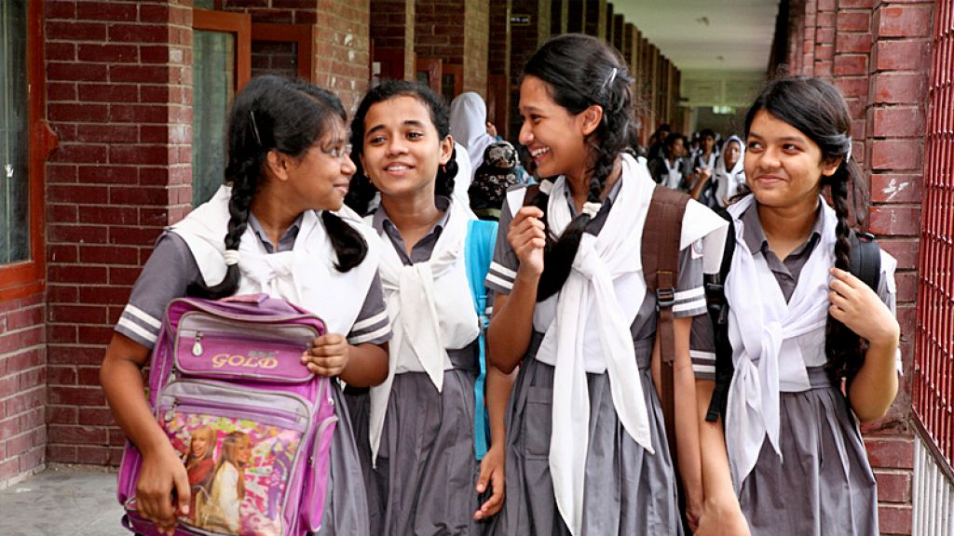
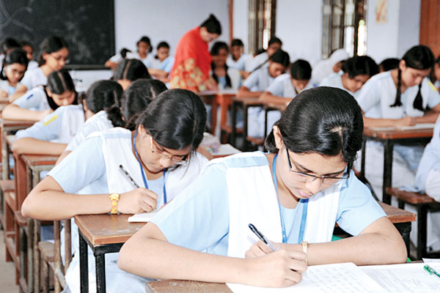
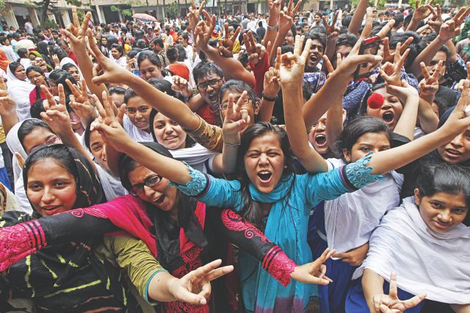
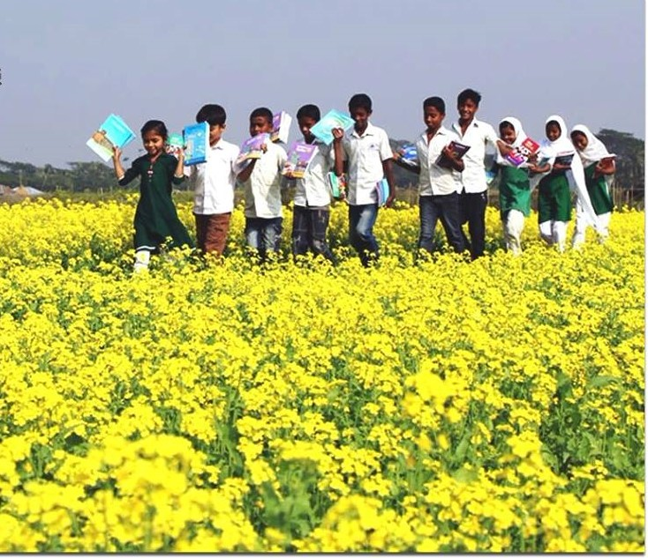
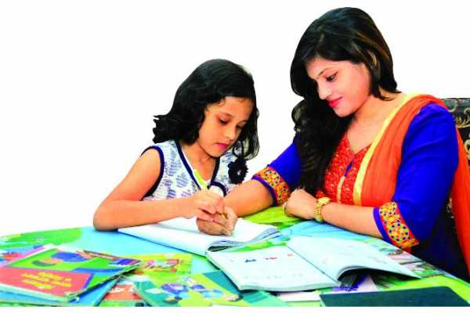
SDG # 4: Ensure inclusive and equitable quality education and promote lifelong learning opportunities for all

Slide 24
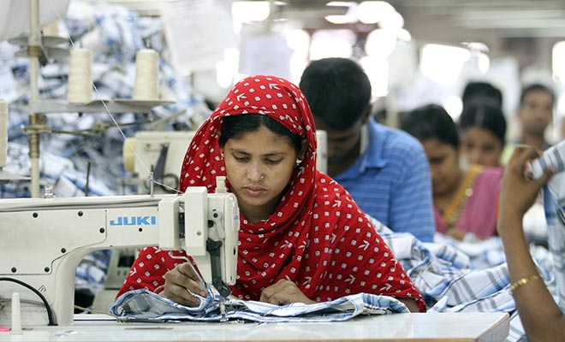
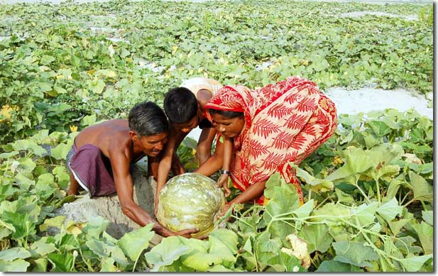
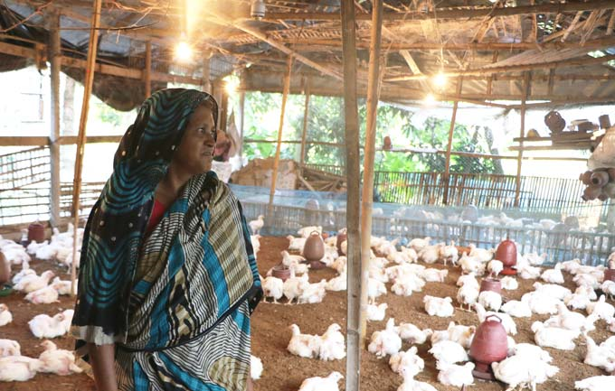
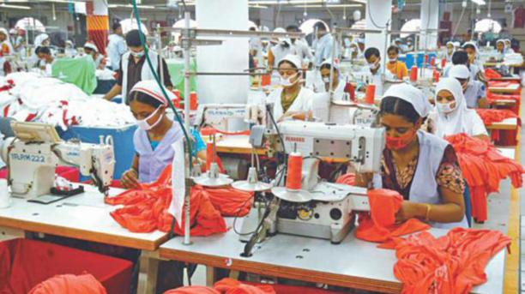
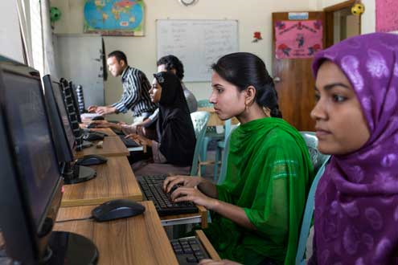
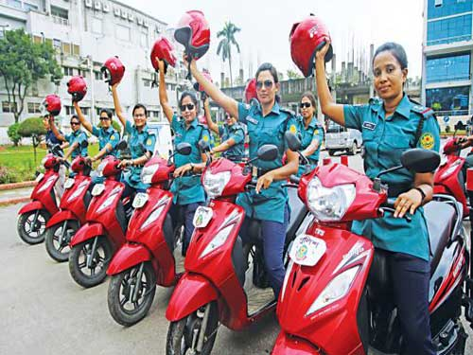
SDG # 5: Achieve gender equality and empower all women and girls

Slide 25

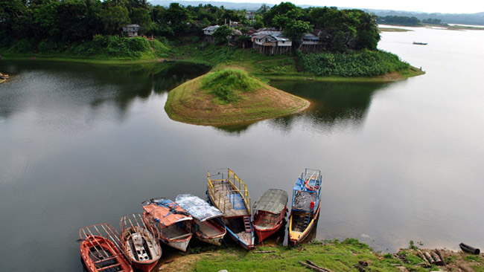
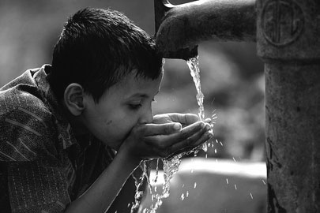
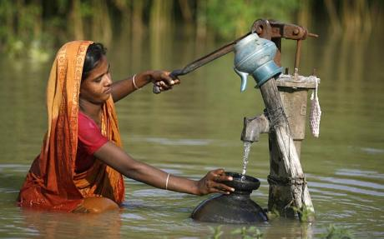
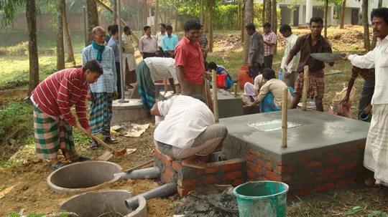
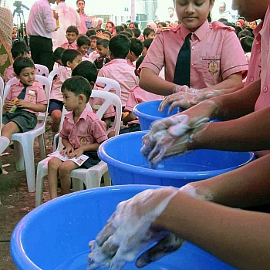
SDG # 6: Ensure availability and Sustainable management of water and sanitation for all

Slide 26


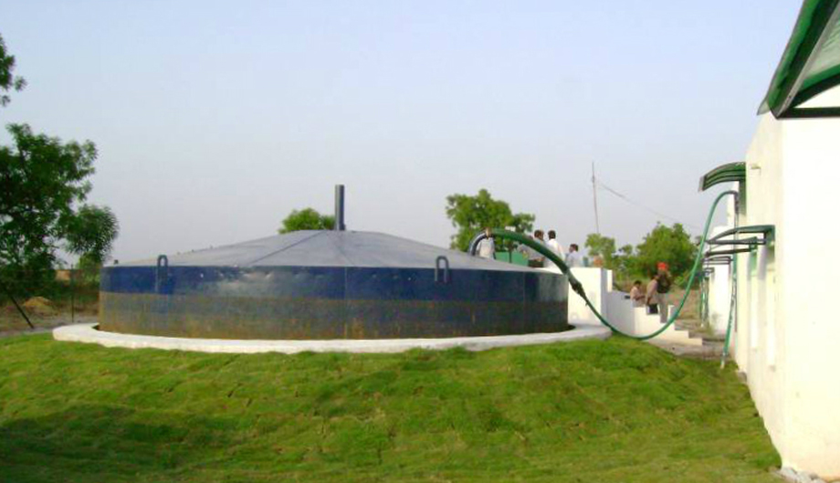
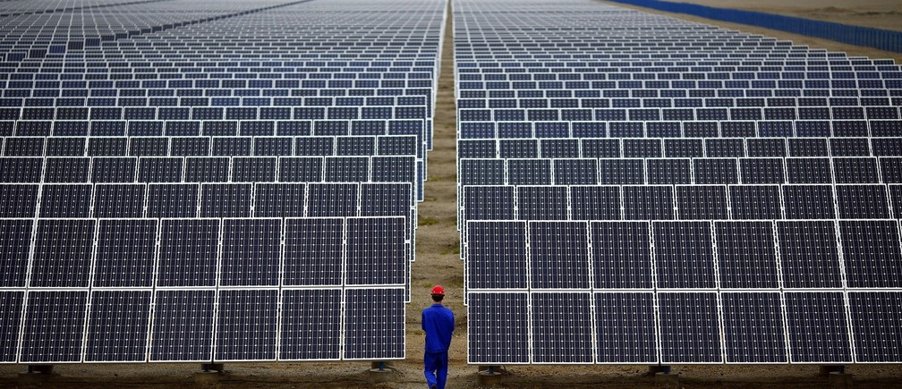
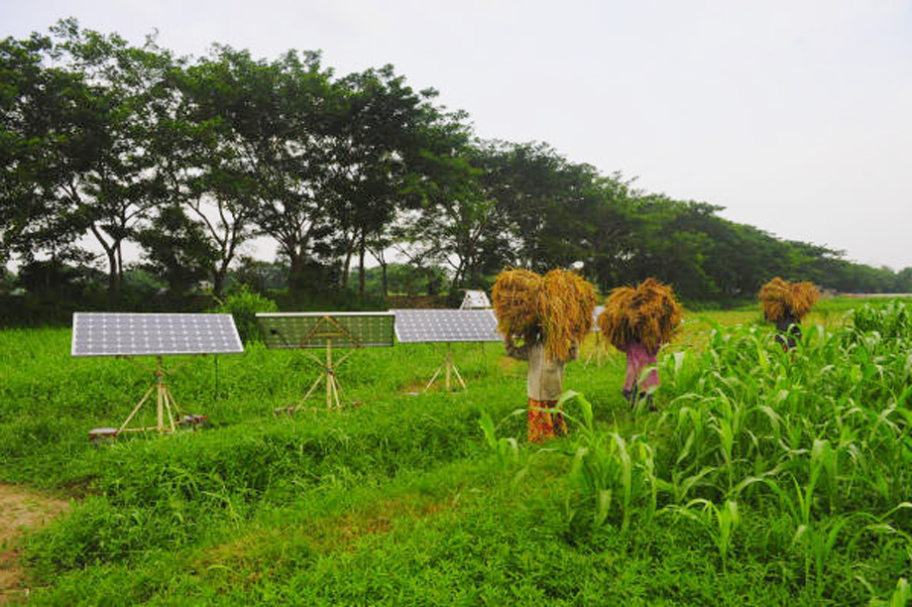
SDG # 7: Ensure access to affordable, reliable, sustainable and modern energy for all

Slide 27
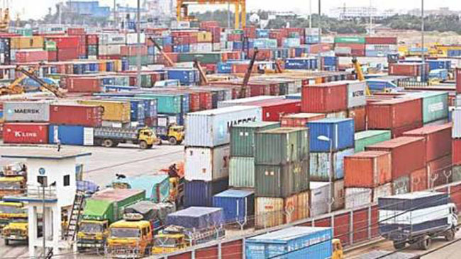
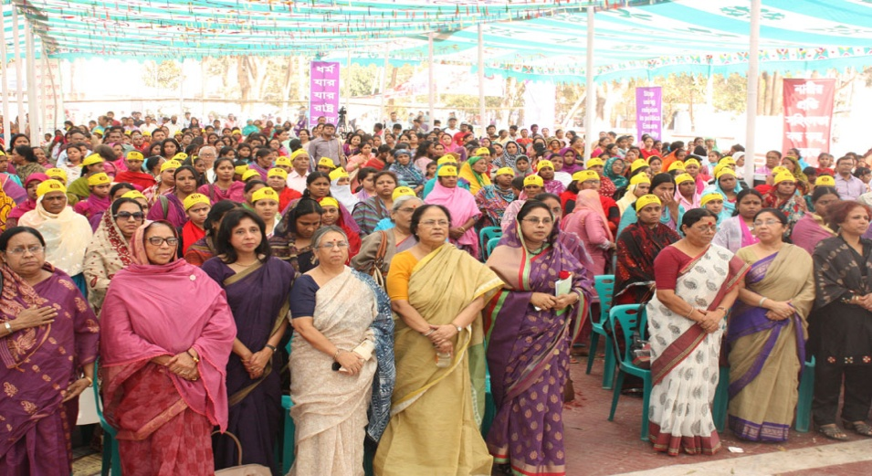




SDG # 8: Promote sustained, inclusive and sustainable economic growth, full and productive employment and decent work for all

Slide 28






SDG # 9: Build resilient infrastructure, promote inclusive and sustainable industrialization and foster innovation

Slide 29






SDG # 10: Reduce inequality within and among countries

Slide 30






SDG # 11: Make cities and human settlements inclusive, safe, resilient and sustainable

Slide 31





SDG # 12: Ensure sustainable consumption and production patterns

Slide 32





SDG # 13: Take urgent action to combat climate change and its impacts

Slide 33




SDG # 14: Conserve and sustainably use the oceans, seas and marine resources for sustainable development

Slide 34






SDG # 15: Protect, restore and promote sustainable use of terrestrial ecosystems, sustainably manage forests, combat desertification, and halt and reverse land degradation, and halt biodiversity loss

Slide 35







SDG # 16: Promote peaceful and inclusive societies for sustainable development, provide access to justice for all and build effective, accountable and inclusive institutions at all levels

Slide 36




SDG # 17: Strengthen the means of implementation and revitalize the global partnership for sustainable development

Slide 37




Each goal is
important
in itself …

Slide 38
Each goal is
important
in itself …
And they
are all
connected

Slide 39

SDGs as a Network of Targets

Slide 40
SDG # 3: Targets (13 including 4 MoI)
Target 3.1: By 2030, reduce the global MMR to less than 70 per 100,000 live births
Target 3.9: By 2030, substantially reduce the number of deaths and illnesses from hazardous chemicals and air, water and soil pollution and contamination
Target 3.2: By 2030, end preventable deaths of new-borns and children under 5 years of age, with all countries aiming to reduce NMR to at least as low as 12 per 1,000 LB and U5MR to at least as low as 25 per 1,000 LB
Target 3.a: Strengthen the implementation of the WHO FCTC in all countries, as appropriate
Target 3.3: By 2030, end the epidemics of AIDS, tuberculosis, malaria and neglected tropical diseases and combat hepatitis, water-borne diseases and other communicable diseases
Target 3.b: Support the R&D of vaccines and medicines for the communicable and NCD that primarily affect developing countries, provide access to affordable essential medicines and vaccines, in accordance with the Doha Declaration on the TRIPS Agreement and PH, which affirms the right of developing countries to use to the full the provisions in the Agreement on Trade Related Aspects of IPRs regarding flexibilities to protect PH, and, in particular, provide access to medicines for all
Target 3.4: By 2030, reduce by one third premature mortality from NCD through prevention and treatment and promote mental health and well-being
Target 3.5: Strengthen the prevention and treatment of substance abuse, including narcotic drug abuse and harmful use of alcohol
Target 3.6: By 2020, halve the number of global deaths and injuries from road traffic accidents
Target 3.c: Substantially increase health financing and the recruitment, development, training and retention of the health workforce in developing countries, especially in least developed countries and small island developing States
Target 3.7: By 2030, ensure universal access to SRH-care services, including for FP, information and education, and the integration of RH into national strategies and programmes
Target 3.d: Strengthen the capacity of all countries, in particular developing countries, for early warning, risk reduction and management of national and global health risks
Target 3.8: Achieve UHC, including financial risk protection, access to quality essential health-care services and access to safe, effective, quality and affordable essential medicines and vaccines for all

Slide 41

17 Goals in 5Ps
Sustainable Development Goals
AMBITION
Social = People
Economic = Prosperity
Environmental = Planet
Leave no one behind & reach furthest behind first
Requires going ‘the last mile’, addressing economic, social, and political factors of exclusion
Implies risk-informed planning, strengthening resilience
Peace
Partnership
“The new agenda is a promise by leaders to all people everywhere. It is an agenda for people, to end poverty in all its forms—an agenda for the planet,” Ban Ki-moon, UN Secretary-General in 70th UNGA

Slide 42


Initiatives of GOB in mainstreaming the Agenda 2030 (SDGs) Implementation

Slide 43

Alignment of SDGs with 7th FYP
As an ‘early starter’ country to implement Agenda 2030, Bangladesh emphasized SDGs while setting up the priority areas for 7th Five Year Plan (2016-20).
A total of 14 goals (82%) are found to be thematically fully aligned with the plan document 3 Goals -Goal 14, Goal 16 and Goal 17 (18%) are partially aligned. | Alignment of SDGs (Goals only) with the 7th Five Year Plan

Slide 44

Alignment of SDGs with 7th FYP (contd)
A total of 58 (34.3%) SDGs targets are found to be aligned with 7th FYP 38 (22.5%) targets are partially aligned 73 (43.2%) targets are not aligned. | Alignment of SDGs (Targets) with the 7th Five Year Plan
Challenges remain in Indicators as around 20% Indicators of SDGs are incorporated in the 7th FYP

Slide 45
Sustainable Development Goals (SDGs): Roadmap for Bangladesh for Implementing Agenda 2030
PMO has created an inter-ministerial committee, “SDGs Implementation and Monitoring Committee” which includes 20 Senior Secretaries/ Secretaries from different ministries/ divisions.
GED is the secretariat for the committee to coordinate the implementation at policy level along with monitoring and reporting SDG attainment status of Bangladesh.
On top an office of Principal Coordinator for SDGs Affairs has been established in PMO to coordinate and facilitate overall implementation and monitoring of SDGs.
SDGs are aligned in the 7th FYP, the National Developmental Plan of Bangladesh.
SDGs Mapping among the Ministries/Divisions have been finalized and published.
SDG Data Gap Analysis has been finalized and published.
National Monitoring and Evaluation (M&E) Framework for SDGs is in the process of finalization.
SDGs Action Plan are in the process of preparation.
A study on SDGs Need Assessment and Financing is being done.
An on-line SDGs Data Repository system is in the process preparation.
Instruction has been given to include SDGs issues in the APA of all Ministries/Divisions/Agencies.
Instruction has been given to include SDGs issues in the different training institutions.

Slide 46
SDG # 3: Data Availability (27 indicators)
Data Readily Available (12)
Data Partially Available (10)
Data Not Available (5)
Tier III (4)
3.4.1: Mortality rate attributed to cardiovascular disease, cancer, diabetes or chronic respiratory disease
3.5.2: Harmful use of alcohol
3.5.1
3.8.1
3.8.2
3.b.1
3.b.3
3.1.1: MMR
3.1.2: Births AB SHP
3.9.1: Mortality rate attributed to household and ambient air pollution
3.2.1: U5 mortality rate
3.4.2: Suicide mortality rate
3.2.2: Neonatal mortality rate
3.5.1: Treatment interventions for substance use disorders
3.9.2: Mortality rate attributed to unsafe water, unsafe sanitation and lack of hygiene
3.3.1: New HIV infections
3.6.1: Death rate due to road traffic injuries
3.3.2: Tuberculosis incidence
3.9.3: Mortality rate attributed to unintentional poisoning
3.3.3: Malaria incidence
3.8.1: Coverage of EHS
3.3.4: Hepatitis B incidence
3.8.2: people covered by health insurance/ a public health system
3.b.3 Proportion of health facilities that have core set of essential medicine
3.3.5: Neglected tropical diseases
3.7.1: Need for FP satisfied
3.a.1: Prevalence of current tobacco use
3.7.2: Adolescent birth rate
3.b.1: population covered by all vaccines
3.b.2: Total net ODA to medical research and basic health sectors
3.c.1: Health worker density and distribution
3.d.1: IHR capacity and health emergency preparedness

Slide 47
Synergies, Trade off and enablers among Targets of SDGs
 | G1 | G2 | G3 | G4 | G5 | G6 | G7 | G8 | G9 | G10 | G11 | G12 | G13 | G14 | G15 | G16 | G17
G1
G2
G3
G4
G5
G6
G7
G8
G9
G10
G11
G12
G13
G14
G15
G16
G17
A blue cell indicates that an improvement in performance for the goal in a given column leads to an improvement in performance for the goal in the corresponding row (i.e. positive synergy).
Vice versa, a red cell indicates that an improvement in the performance for goal in a given column leads to a deterioration in performance for the goal in the corresponding row (i.e. negative synergy).
Synergies among goals can also change sign depending on the country’s context and the specific policy intervention adopted (cells highlighted in yellow for G9 and G15).
The matrix maps direct causal connections between goals (i.e. not through another goal).

Slide 48


Mapping of Ministries/Divisions by SDG Targets

Slide 49
SDG Mapping (Who to do what)

Slide 50
Lead Ministries/Divisions for Implementing SDGs

Slide 51
Co-Lead Ministries/Divisions for Implementing SDGs

Slide 52

Draft Monitoring and Evaluation (M&E) of Sustainable Development Goal-3

Slide 53
2.2.1 Prevalence of stunting among children under 5 years of age

Slide 55
3.1.1: Maternal mortality ratio (per 100,000 LB)

Slide 56
3.1.2:Proportion of births attended by skilled health personnel

Slide 57
3.2.2: Neonatal mortality rate (per 1000 LB)

Slide 58
3.3.1: Number of new HIV infections per 1,000 uninfected population, by sex

Slide 59
3.3.2: Tuberculosis incidence per 100,000 population

Slide 60
3.3.3: Malaria incidence per 1,000 population

Slide 61
3.3.4: Hepatitis B incidence per 100,000 population

Slide 62
3.3.5: Number of people requiring interventions against neglected tropical diseases

Slide 63
3.4.1: Mortality rate attributed to cardiovascular disease, cancer, diabetes or chronic respiratory disease

Slide 64
3.4.2: Suicide mortality rate (per 100,000 population)

Slide 65
3.5.2: Harmful use of alcohol, defined according to the national context as alcohol per capita consumption (aged 15 years and older) within a calendar year in litres of pure alcohol

Slide 66
3.6.1: Death rate due to road traffic injuries

Slide 67
3.7.1: Proportion of women of reproductive age (aged 15-49 years) who have their need for family planning satisfied with modern methods

Slide 68
3.7.2: Adolescent birth rate (aged 10-14 years; aged 15-19 years) per 1,000 women in that age group

Slide 69
3.8.1 Coverage of essential health services (defined as the average coverage of essential services based on tracer interventions that include reproductive, maternal, new-born and child health, infectious diseases, non-communicable diseases and service capacity and access, among the general and the most disadvantaged population)

Slide 70
3.8.2: Number of people covered by health insurance or a public health system per 1,000 population

Slide 71
3.9.1: Mortality rate attributed to household and ambient air pollution (per 100000 population)

Slide 72
3.9.2: Mortality rate attributed to unsafe water, unsafe sanitation and lack of hygiene (per 100,000 population)

Slide 73
3.9.3: Mortality rate attributed to unintentional poisoning (per 100,000 population)

Slide 74
3.a.1: Age-standardized prevalence of current tobacco use among persons aged 15 years and older

Slide 75
3.b.1: Proportion of the population with access to affordable medicines and vaccines on a sustainable basis

Slide 76
3.b.2: Total net official development assistance to medical research and basic health sectors

Slide 77
3.c.1: Health worker density and distribution (per 10,000 population)

Slide 78
3.d.1: International Health Regulations (IHR) capacity and health emergency preparedness

Slide 79


"Let us together create a world that can eradicate poverty, hunger, war and human sufferings and achieve global peace and security for the well being of humanity."
Bangabandhu Sheikh Mujibur Rahman,
Founding Father of Bangladesh

Slide 80

The woods are lovely, dark and deep, But I have promises to keep, And miles to go before I sleep, And miles to go before I sleep.
THANK YOU ALL

